Slide 1
Using Chemical Formulas
Unit 5 part 3 (supliment to naming notes)

Slide 2
Chemical Formulas Indicate:
Elements present in compound
Relative number of atoms or ions of each element in a compound
Can also calculate characteristic values for a compound:
Formula mass
Molar mass
Percentage composition

Slide 3
Few Definitions
Formula mass- of molecule, formula unit or ion is the SUM of the average atomic masses of all atoms in its formula
Ex: Water (H₂0)
average mass of H₂O molecule: 18.02 amu

Slide 4
Molar Mass Conversions
Sample Problem I
Ibuprofen, C₁₃H₁₈O₂, is the active ingredient in many
nonprescription pain relievers. Its molar mass is
206.31 g/mol.
If the tablets in a bottle contain a total of 33 g of ibuprofen, how many moles of ibuprofen are in the bottle?
How many molecules of ibuprofen are in the bottle?
What is the total mass in grams of carbon in 33 g
of ibuprofen?

Slide 5
Sample Problem I Solution
Given: 33 g of C₁₃H₁₈O₂
molar mass 206.31 g/mol
Unknown: a. moles C₁₃H₁₈O₂
b. molecules C₁₃H₁₈O₂
c. total mass of C
Solution: a. grams moles

Slide 6
Sample Problem I Solution, continued
b. moles molecules
c. moles C₁₃H₁₈O₂ moles C grams C

Slide 7
A.
B.
C.

Slide 8
Percentage Composition
It is often useful to know the percentage by mass of a particular element in a chemical compound.
To find the mass percentage of an element in a compound:
The mass percentage of an element in a compound is the same regardless of the sample’s size

Slide 9
Percentage of an element in compound is calculated by how many grams of the element are present in 1 mole of compound.
PERCENTAGE COMPOSITION The percentage by mass of each element in a compound

Slide 10
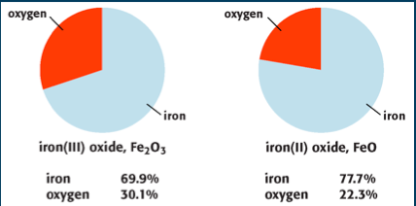
% Comp of Iron Oxides

Slide 11
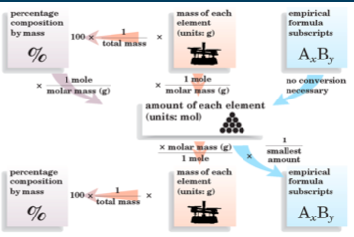

Slide 12
Find the percentage composition of copper (1) sulfide, Cu₂S
Given: Cu₂S
Unknown: % comp of Cu₂S
SO….
Formula then molar mass then mass % of each element. (This is your path young Skywalker)

Slide 13
Molar mass of Cu₂S = 159.2 g

Slide 15
STOP!!!!!
Hammer Time!

Slide 16
For Our Next and Final Trick…..
We will…..
Define an empirical formula
Determine an empirical formula
Determine a molecular formula from an empirical formula.

Slide 17
For percentage composition
Divide the amount of element’s mass by the total mass of the compound. Multiple by 100 then you have the percentage of the element in the compound.

Slide 18
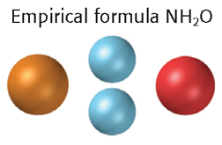
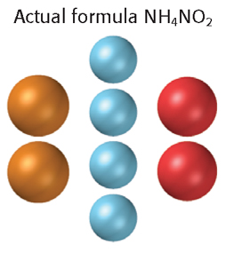
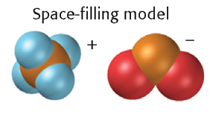

Slide 19
Empirical formulas are symbols for the elements in compound. They have the subscripts that show the SMALLEST WHOLE NUMBER MOLE RATIO OF DIFFERENT ATOMS IN COMPOUND.
For ionic compounds the formula unit is usually the compound’s empirical formula.

Slide 20
For molecular compounds the empirical formula doesn’t necessarily indicate the actual numbers of atoms present in each molecule.
Example:
Empirical formula: BH₃
Molecular formula: B₂H₆

Slide 21
To find an empirical formula from percentage composition:
Calculate % composition to a MASS composition
Assume 100.0g sample of compound
Calculate amount of each element in sample

Slide 22
Diborane:
% comp is 78.1% B and 21.9% H
So 100.0g diborane has 78.1g B and 21.9g H
Then mass of each element is converted to a composition in moles by dividing by appropriate molar mass

Slide 23
Values give a mole ration of
7.22 mol B to 21.7mol H

Slide 24
Then find smallest whole number ratio, divide each number of moles by smallest number in ratio
Because of rounding or experimental error a compound’s mole ratio is sometimes numbers close to whole numbers instead of exact whole numbers. If the case then nearest whole number is taken.

Slide 25
Practice:
Given: 32.38% sodium, 22.65% sulfur, and 44.99% oxygen.
Unknown: Empirical formula
Solution- %comp to mass comp to comp in moles to smallest whole-number mole ratio of atoms

Slide 27
The compound’s ratio is:
Rounding yields a mole ratio of 2:1:4 so the empirical formula is Na₂SO₄

Slide 28
The formula masses have a similar relationship.
x(empirical formula mass) = molecular formula mass
To determine the molecular formula of a compound, you must know the compound’s formula mass.
Dividing the experimental formula mass by the empirical formula mass gives the value of x.
A compound’s molecular formula mass is numerically equal to its molar mass, so a compound’s molecular formula can also be found given the compound’s empirical formula and its molar mass.

Slide 29
Now practice calculation of molecular formulas:
Sample Problem N
In Sample Problem M, the empirical formula of a compound of phosphorus and oxygen was found to be P₂O₅. Experimentation shows that the molar mass of this compound is 283.89 g/mol. What is the compound’s molecular formula?

Slide 30
Sample Problem N Solution
Given: empirical formula
Unknown: molecular formula
Solution:
x(empirical formula) = molecular formula

Slide 31
Sample Problem N Solution, continued
Molecular formula mass is numerically equal to molar mass.
molecular molar mass = 283.89 g/mol
molecular formula mass = 283.89 amu
empirical formula mass
mass of phosphorus atom = 30.97 amu
mass of oxygen atom = 16.00 amu
empirical formula mass of P₂O₅ =
2 × 30.97 amu + 5 × 16.00 amu = 141.94 amu

Slide 32
Sample Problem N Solution, continued
Dividing the experimental formula mass by the empirical formula mass gives the value of x.
2 × (P₂O₅) = P₄O₁₀
The compound’s molecular formula is therefore P₄O₁₀.

