Slide 1
Naming Notes
Part 2

Slide 2
Oxyanions
Polyatomic ions that contain oxygen
Sometimes can form more than one type of oxyanion
Example Nitrogen can form NO₃⁻ or NO₂⁻
When naming them the one with the greater oxygen content ends in –ate and the one with the smaller oxygen content ends in -ite

Slide 3
Chlorine can form more than two types of oxyanions examples include:
ClO⁻ (hypochlorite)
ClO₂⁻ (chlorite)
ClO₃⁻ (chlorate)
ClO₄⁻ (perchlorate)
An ion with more then one oxygen atom than the –ate anion has is given the prefix per-

Slide 4
Practice:
Write the formula for tin(IV) sulfate
Cross the charges to give subscripts and add parentheses around the polyatomic ion if necessary
Cross over the charges to give subscripts and add parentheses around the polyatomic ion if necessary

Slide 5
Naming Binary Molecular Compounds
Unlike ionic compounds, molecular compounds are composed of individual covalently bonded units, or molecules.
As with ionic compounds, there is also a Stock system for naming molecular compounds.
The old system of naming molecular compounds is based on the use of prefixes.
examples: CCl₄ — carbon tetrachloride (tetra- = 4) CO — carbon monoxide (mon- = 1) CO₂ — carbon dioxide (di- = 2)

Slide 6
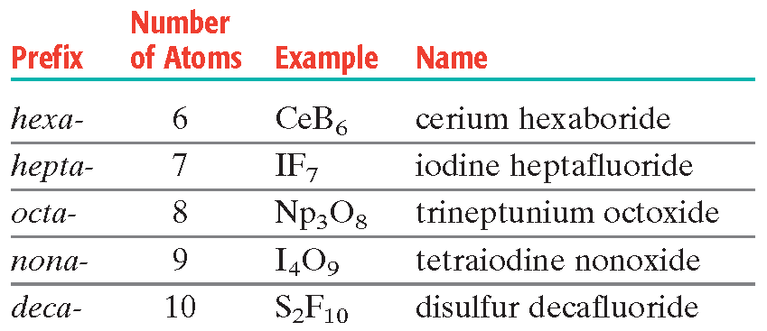
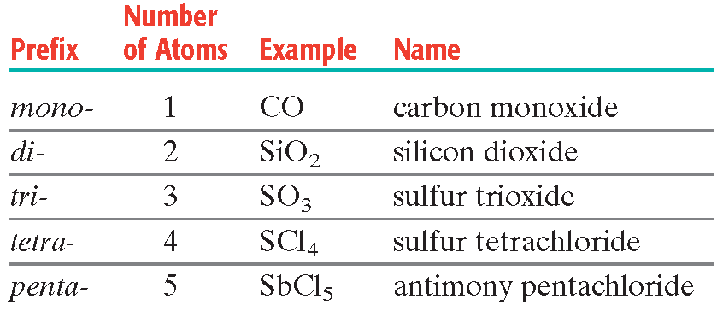
Prefixed for Covalent Compounds

Slide 7
.
Name the compound that contains two arsenic atoms and five oxygen atoms
diarsenic pentoxide

Slide 8
two arsenic atoms, so the first word in the name is.
The five oxygen atoms are indicated by adding the prefix pent- to the word oxide.
The complete name is diarsenic pentoxide

Slide 9
Write the formula for oxygen difluoride
Oxygen is first in the name because it is less electronegative than fluorine.
Because there is no prefix, there must be only one oxygen atom.
The prefix di- in difluoride shows that there are two fluorine atoms in the molecule.
The formula is OF₂

Slide 10
Practice:
SiC
silicon carbide
SiO₂
silicon dioxide
Si₃N₄
trisilicon tetranitride

Slide 11
Acids and Salts
An acid is either an oxyacid or binary acid
Binary acids- acids that consist of two elements usually hydrogen and a halogen
Oxyacids- acids that contain hydrogen, oxygen, and a third element (usually a nonmetal)

Slide 12
In the laboratory, the term acid usually refers to a solution in water of an acid compound rather than the acid itself.
example: hydrochloric acid refers to a water solution of the molecular compound hydrogen chloride, HCl
Many polyatomic ions are produced by the loss of hydrogen ions from oxyacids.
examples:
Sulfuric acid sulfate
Nitric acid nitrate
Phosphoric acid phosphate

Slide 13
An ionic compound composed of a cation and the anion from an acid is often referred to as a salt.
examples:
Table salt, NaCl, contains the anion from hydrochloric acid, HCl.
Calcium sulfate, CaSO₄, is a salt containing the anion from sulfuric acid, H₂SO₄.
The bicarbonate ion, HCO₃⁻, comes from carbonic acid, H₂CO₃.

Slide 14
Oxidation Numbers
The charges on the ions in an ionic compound reflect the electron distribution of the compound.
In order to indicate the general distribution of electrons among the bonded atoms in a molecular compound or a polyatomic ion, oxidation numbers are assigned to the atoms composing the compound or ion.
Unlike ionic charges, oxidation numbers do not have an exact physical meaning: rather, they serve as useful “bookkeeping” devices to help keep track of electrons.

Slide 15
Assigning Oxidation Numbers
In general when assigning oxidation numbers, shared electrons are assumed to “belong” to the more electronegative atom in each bond.
More-specific rules are provided by the following guidelines.
The atoms in a pure element have an oxidation number of zero.
examples: all atoms in sodium, Na, oxygen, O₂, phosphorus, P₄, and sulfur, S₈, have oxidation numbers of zero.

Slide 16
Assigning oxidation numbers (cont)
The more-electronegative element in a binary compound is assigned a negative number equal to the charge it would have as an anion. Likewise for the less-electronegative element.
Fluorine has an oxidation number of –1 in all of its compounds because it is the most electronegative element.

Slide 17
Cont……..
Oxygen usually has an oxidation number of –2.
Exceptions:
In peroxides, such as H₂O₂, oxygen’s oxidation number is –1.
In compounds with fluorine, such as OF₂, oxygen’s oxidation number is +2.
Hydrogen has an oxidation number of +1 in all compounds containing elements that are more electronegative than it; it has an oxidation number of –1 with metals.

Slide 18
And finally…..
The algebraic sum of the oxidation numbers of all atoms in an neutral compound is equal to zero.
The algebraic sum of the oxidation numbers of all atoms in a polyatomic ion is equal to the charge of the ion.
Although rules 1 through 7 apply to covalently bonded atoms, oxidation numbers can also be applied to atoms in ionic compounds similarly.

Slide 19
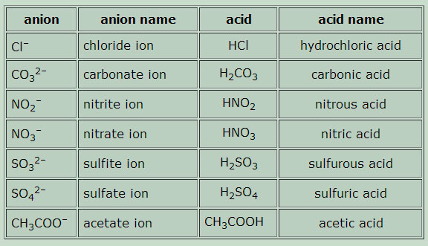
Common Acid Nomenclature

