Slide 1
Unit 3
Periodic Law
Shout out to Holt, Rinehart and Winston

Slide 2
outline
I. History
II. Modern Periodic Table
III. Trends of Periodic Table
IV. Ionization Energy
V. Valence Electrons

Slide 3
Objectives:
Explain the relationship between electrons in sublevels and the length of each period of the periodic table.
Locate and name the four blocks of the periodic table. Explain the reasons for these names.

Slide 4
I. History of periodic table of elements: Mendeleev
Arranged elements in order of increasing atomic mass and he noticed that similarities in the elements chemical properties appeared at regular intervals.
Referred to as periodic. Repeating patterns.
Thus, he created a table where he grouped elements with similar properties

Slide 5
Mendeleev noticed empty spaces after he arranged all the known elements of his time.
1871 he predicted existence and properties of those elements. Three spaces would be filled in the rest of his days. 1886.
Gallium 1875
Scandium 1877
Germanium 1886

Slide 6
Mosely and periodic law
1911 Henry Moseley arranged elements by atomic number and the patterns of the elements “fit” better.
This leads to the Periodic Law:
Physical and chemical properties of elements are periodic functions of their atomic numbers.

Slide 7
II. Modern periodic table
It is arranged with elements in order of atomic numbers.
Elements with similar properties are in the same column or group.
Discuss the relationship between group configurations and group numbers.
Describe the locations in the periodic table and the general properties of the alkali metals, the alkaline-earth metals, the halogens, and the noble gases.

Slide 8
Periods and blocks
Vertical arrangement holds groups that share similar chemical properties
Horizontal rows (periods). Length is determined by number of electrons that can occupy the sublevels being filled in that period.
Oh yeah and the four blocks:
s, p, d, and f
Each block is determined by the electron sublevels filled in that block. REMEMBER?

Slide 9
Group 1: alkali Metals
In pure state they all have silvery appearance and are soft. Very reactive, unstable.
Lithium
Sodium
Potassium
Rubidium
Cesium
Francium

Slide 10
Group 2: alkaline-earth metals
Less reactive than group 1.
Too reactive to be found in pure form.
Beryllium
Magnesium
Calcium
Strontium
Barium
Radium

Slide 11
*Special elements*
Hydrogen
Doesn’t share the properties of group 1. 1s¹ configuration.
Helium
Highest energy level is filled. Helium has a special chemical stability. 1s² configuration.

Slide 12
Group 17: Halogens
Most reactive nonmetals.
React vigorously with most metals. SALTS.

Slide 13
Lanthanides
1st row of f block.
Shiny metals reactivity to the alkaline metals (group 2)

Slide 14
Actinides
2nd row of the f block.
All RADIOACTIVE!!!!!!

Slide 15
III. Trends of periodic table
Objectives:
Define trend
Describe trends; fashion, behavior, color, design, and foods.
Define, compare
Periodic trends of atomic radii, ionization energy, electronegativity. Why is there variations.
Define
Valence electrons and presence of them in each group.

Slide 16
Atomic radii
Radii of an atom can vary under various conditions so the boundaries of atoms are “fuzzy”
So measurement is under specific conditions.
Atomic radius: ½ the distance between the nuclei of identical atoms that are bonded together.

Slide 17
More on radii
Atoms tend to be smaller the farther to the right across a period.
Trend of smaller atoms across a period is because of increasing positive charge of the nucleus that attracts electrons toward the nucleus.
Atoms farther down a group tend to be larger. This is because of the increasing size of electron cloud as the electron sublevels increase.

Slide 18
IV. (Ionization Energy)
Ion
An atom or group of atoms with a net electric charge. They get this charge by gaining or losing electrons. Either one or more than one can be lost to make an ion. Ionization formation of an ion.

Slide 19
Cations
Ion or group of ions with a positive charge. Removal of electrons which leads to decreased atomic radius. Will move toward the negative electrode in electrolysis.
Anions
Ion with a negative charge. Addition of one or more electrons. Increases the atomic radius. Will move toward the anode in electrolysis.

Slide 20
Cationic and anionic radii decrease across a period.
The electron cloud shrinks due to the increasing nuclear charge acting on the electrons in the same main energy level.
The outer electrons in both cations and anions are in higher energy levels as one reads down a group.
There is a gradual increase of ionic radii down a group.

Slide 21
Ionization energy, IE (first ionization energy, IE₁)
Energy required to remove one electron from a neutral atom of an element
Increases across each period (because of increasing nuclear charge). Higher the charge the stronger the attraction of electrons in the same energy level.

Slide 22
Ionization energies generally decrease down the groups.
Electrons removed from atoms of each succeeding element in a group are in higher energy levels, farther from the nucleus.
Electrons removed easier.

Slide 23
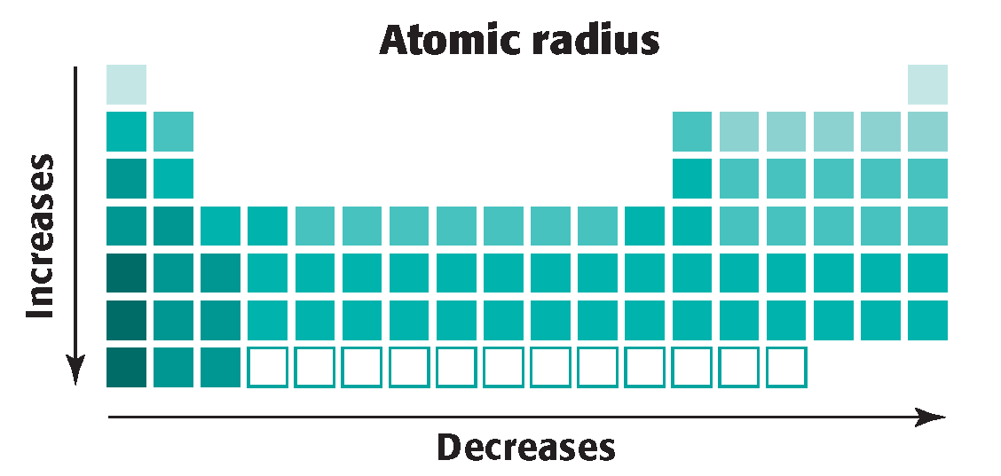
Radii trends

Slide 24
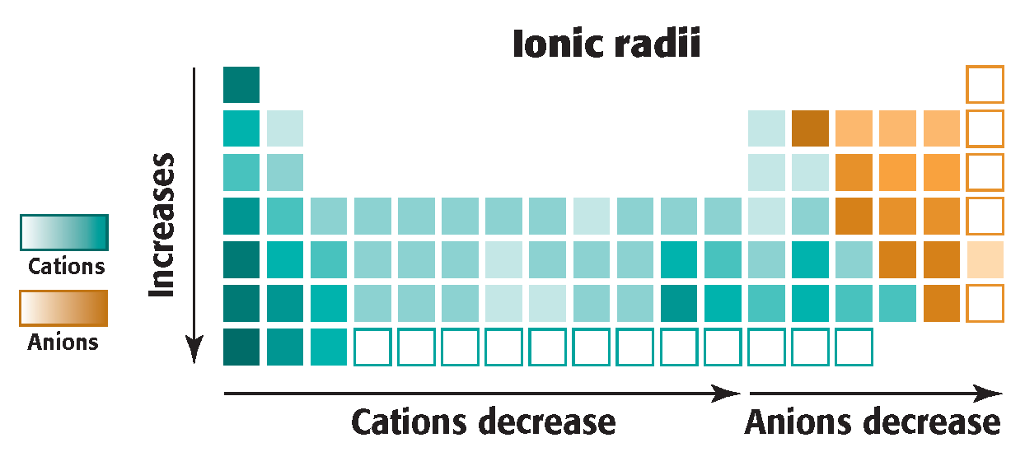

Slide 25
V. Valence electrons
Compounds form because of losing, gaining, or sharing electrons between atoms.
Electrons in highest energy levels interact this way.
Valence electrons: electrons available to share, gained or lost when forming a chemical compounds. Often found in unfilled main-energy levels. Ex: Group 1 have 1 valence electrons and the noble gases have no valence electrons.

Slide 26
Compounds are held together by the valence electrons.
FYI: Many compounds have a negative charged valence electrons are closer to one atom than another.
Electronegativity: measurement of an atom in a chemical compound to attract electrons from another atom in the compound.
Tends to:
increase across periods
decreases or remains about the same down a group.

