Slide 1
States of Matter
Fisher
By PresenterMedia.com

Slide 2
Kinetic-Molecular Theory of Gases
Based on 5 assumptions. Only apply to IDEAL GASES!
Gases have large numbers of particles that are far apart relative to their size. (The volume of a gas is largely empty space)
Collisions of gas particles and particles with container walls are elastic. (No net loss in kinetic energy)
Gas particles have kinetic energy because the particles are continuously in random, rapid, motion.
No forces of attraction exist between particles of gas.
Temperature of a gas is dependent on average kinetic energy of gas particles.

Slide 3
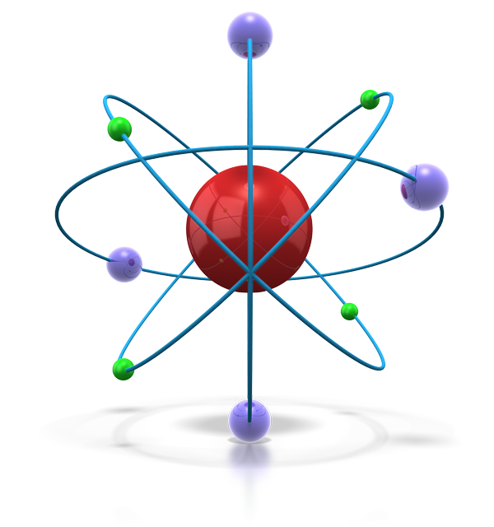
Some phases to remember
Freezing
Liquid solid + energy
Loss of energy (heat) by the liquid
Freezing Point
Temperature where solid and liquid are in equilibrium
At 1 atm (760 torr, or 101.3 kPa) pressure
Melting
solid + energy liquid The reverse of freezing. DUH
Equilibruim
solid + energy liquid
Melting and freezing are at equal rates
Phase diagram
Graph of pressure vs. temperature which shows conditions of phases of a substance exist

Slide 4
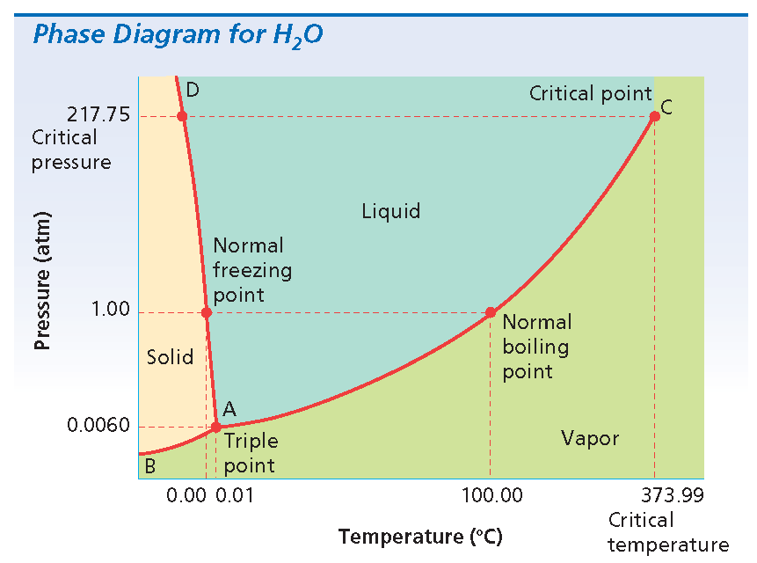
Picture Page Layout
Picture Caption Here

Slide 5
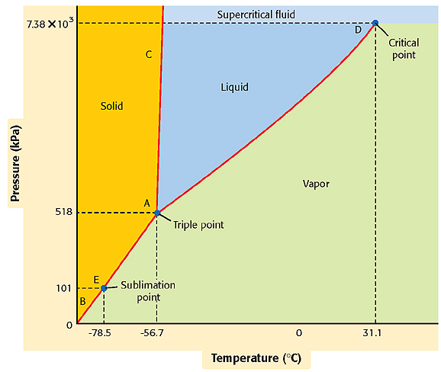
Phase Diagram for CO₂

Slide 6
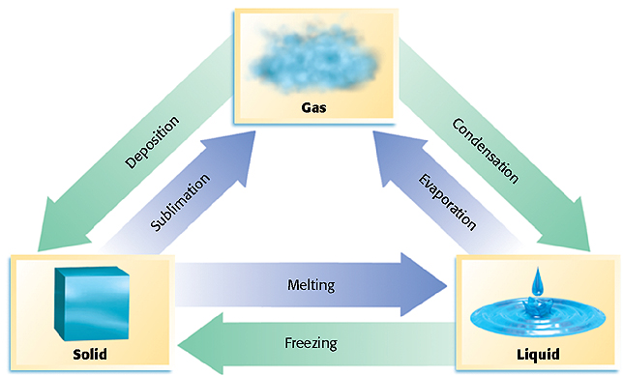
Changes of State

Slide 7
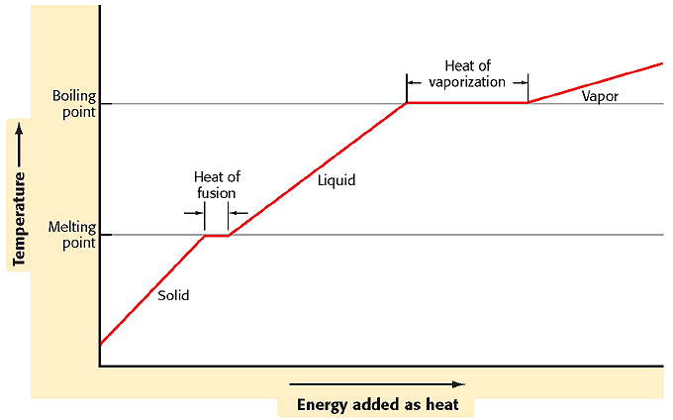
Heating Curve of Water

Slide 8
How much energy is absorbed
When 47.0g of Ice melts at STP?
How much energy is absorbed when this same mas of liquid water boils?
Given: Mass of H2O (s) = 47.0g
Mass of H2O (l) = 47.0g
Molar enthalpy of fusion of ice = 6.008 kJ/mol
Molar enthalpy of vaporization = 40.79 kJ/mol
Unknown: energy absorbed when ice melts;
energy absorbed when liquid water boils

Slide 9
Sample Problem
Solution:
Convert the mass of water from grams to moles.
47.0 g H₂O X 1 mol H₂O/18.02 g H₂O = 2.61 mol H₂O
2.61 mol X 6.009 kJ/mol =
15.7 kJ (on melting)
2.61 mol X 40.79 kJ/mol =
106 kJ (on vaporizing or boiling)

