Slide 1
Organic Chemistry
A Brief overview that doesn’t do the topic justice

Slide 2
Organic chemistry deals with the chemistry of all life on earth. It plays a part in understanding and developing food, drugs, plastics, petrochemicals, paint and explosives.

Slide 3
Organic Compounds
All have carbon atoms however, not all carbon-containing compounds are organic.
Ex: Na₂CO₃, CO, and CO₂
Organic compounds- covalently bonded compounds containing carbon. Doesn’t include carbonates and oxides.

Slide 4
Why Carbon is way cool!
Uniqueness in the structures and bonding abilities.
They can form long chains and rings of covalently bonded atoms.
Catenation- bonding of an element to itself to create the rings or chains.
The C in such structures can be single, double, or triple covalent bonds.
C atoms can also bind with elements similar in electronegativity.

Slide 5
Hydrocarbons
These only have C and H in the compounds.
Other organic compounds contain hydrocarbon backbones where other elements are attached. O, N, S and halogens.

Slide 6
Atom Arrangement with Organic Compounds
Some compounds may contain the same atoms but have different properties because the atoms are arranged differently.
C₂H₄O is ethanol and dimethyl ether
Isomers- compounds with same molecular formula and different structures.

Slide 7
Structural Formulas
In organic chemistry structures are used to represent organic compounds.
Structural formula- provides the number and types of atoms in a molecule & shows bonding arrangement of the atoms.
C₄H₁₀
Don’t show the 3D shape of molecules.

Slide 8
Condensed structures
Easier to read.
Bonds to H are not shown, they are understood to bind to atom they are written beside.
Example on left is structural and on right is condensed formulas

Slide 9
Isomers, again
Same molecular formula and different structural formulas. Remember?
Structural isomer- aka a constitutional isomer, atoms are bonded together in different orders.
C₄H₁₀

Slide 10
Geometric isomers- order of atom bonding is the same but the arrangement of atoms in space is different.
Ex: 1,2-dichloroethene geometric isomers

Slide 11
What is next?

Slide 12
Hydrocarbons TAKE 2!!
What are they again?
Saturated hydrocarbons- C atom in molecule forms 4 single covalent bonds with other atoms.

Slide 13
Alkanes
Alkanes- hydrocarbons with single bonds
Single-chain alkanes differ by 1 C and 2 H.
These are homologous series- adjacent members differ by a constant unit.

Slide 14
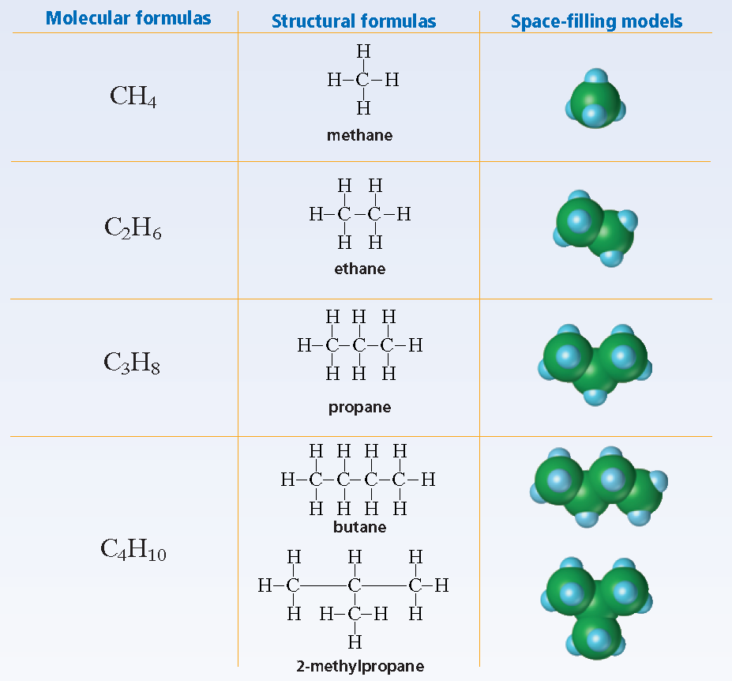
Alkanes

Slide 15
Cycloalkanes- alkanes where the C atoms are arranged in a ring, or cyclic, structure.
Skeletal representation

Slide 16
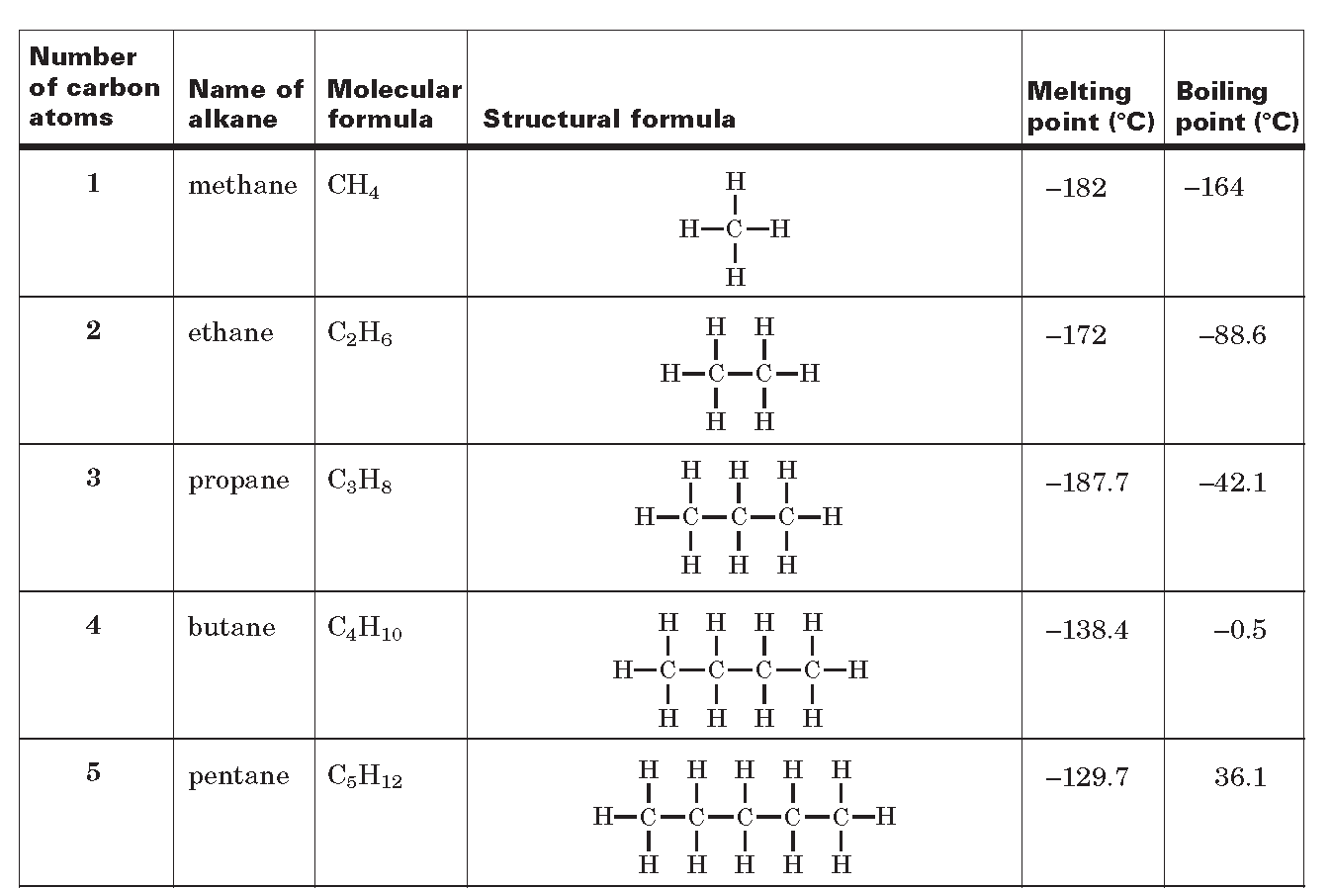

Slide 17
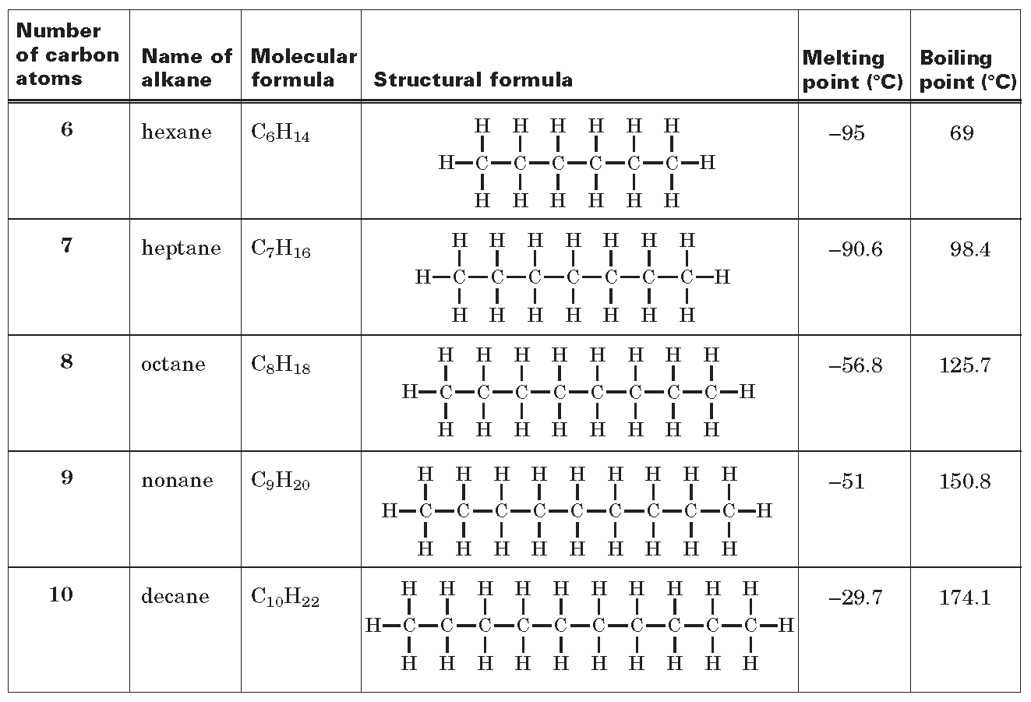

Slide 18
HIGHLIGHTS
Carbon’s ability to bond to elements and allow different arrangement of atoms contributes to diversity of carbon compounds
Isomers are compounds that have the same molecular formula and different structures.

Slide 19
HIGHLIGHTS 2
Alkanes are saturated hydrocarbons; they have single bonds. The trends in alkanes correspond to trends in alkane size and amount of branching.
Organic compounds are named according to a systematic method.
Unsaturated hydrocarbons have one or more multiple carbon-carbon bonds; include alkenes, alkynes, and aromatic hydrocarbons

Slide 20
HIGHLIGHTS 3
Functional groups are responsible for the properties of the organic compound that contains the functional group.
Alcohols contain the hydroxyl functional groups.
Alkyl halides contain one or more halogen atoms.
2 alkyl groups are joined to an oxygen atom in ethers.
Amines are derivatives of ammonia.
Carboxylic acids contain carboxyl groups.

Slide 21
Functional Groups Websites
http://uhill-chemistry.wikispaces.com/Organic+Chemistry+-+Functional+Groups
http://wps.prenhall.com/wps/media/objects/3313/3393159/blb2505.html
Check out crash courses on organic chemistry. They are great.

Slide 22
Alkane- a saturated hydrocarbon with hydrogen and carbon atoms, all bonds are single bonds.
Single bond for the carbons, names end with “a”.
Alkene- an unsaturated compound with one carbon-carbon double bond.
Double bond for the carbons, names end with “e”.
Alkyne- an unsaturated hydrocarbon with at least one; carbon—carbon triple bond between two carbon atoms.
Triple bond for the carbons, names end with “y”.

Slide 23
Sooooo Here are some words you may find useful
Organic compounds
Hydrocarbon
Isomer
Saturated and Unsaturated hydrocarbons
Alkane
Alkene
Alkyne
Cycloalkane

Slide 24
Functional group
Alcohol
Alkyl halide
Ether
Aldehyde
Ketone
Amine
Carboxylic acid
Ester

Slide 25
Polymer
Monomer
Copolymer

