Slide 1
Covalent &Metallic Bonding and VSEPR
Bonding Part 4

Slide 2
Covalent and Molecular Compounds
Molecule- neutral group of atoms held together by covalent bonds.
Molecular compound- chemical compound simplest units
Chemical formula- relative numbers of atoms of each kind in chemical compound
Molecular formula- single molecule of a molecular compound; H₂O
Diatomic molecule- containing only two atoms; O₂
Structural formula- shows kind, number, arrangement, and bonds but NOT the unshared pairs of atoms in a molecule; F-F or H-Cl

Slide 3
Objectives:
Explain:
  Shiny metallic surfaces
  Metals are good electrical conductors
  Why metals are malleable and ductile

Slide 4
Outline:
I. Metallic Bonding
II. Molecular Geometry
III. VSEPR Theory
IV. Hybridization
V. Intermolecular Forces

Slide 5
I. Metallic Bonding
Characteristics:
  Electrical conductivity
  Thermal conductivity
  Malleability (ability to be hammered or beaten into thin sheets)
  Ductility (ability to be drawn or pulled into wire)
  Shiny appearance

Slide 6
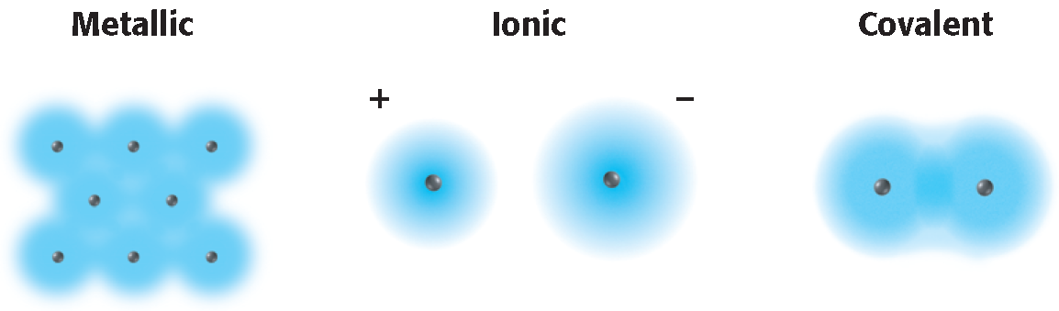
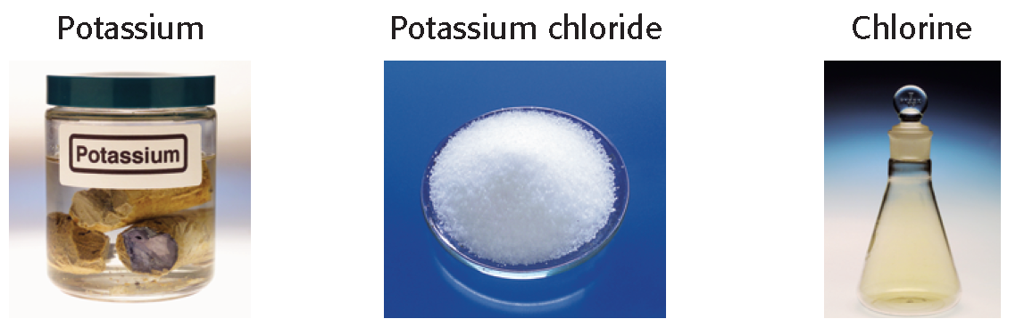

Slide 7
Metallic-Bond Model
In metals, vacant orbitals of the outer energy levels overlap.
Overlapping orbitals allow the outer electrons of atoms to roam freely through the entire metal.

Slide 8
Delocalized- the electrons do not belong to any one atom and they move freely in the network of the metals’ empty atomic orbitals.
Sea of electrons- the mobile electrons in the metal atoms are packed together in a crystal lattice. The result of attraction is metallic bonding.

Slide 9
II. Molecular Geometry
Molecular Geometry- the three dimensional arrangement of a molecule’s atoms.
Molecular Polarity- uneven distribution of molecular shape.
  Polarity influences the forces between molecules in liquids and solids.

Slide 10
III. VSEPR Theory
V- valence
S- shell
E- electron
P- pair
R- repulsion

Slide 11
VSEPR theory states:
  Repulsion between the sets of valence-level electrons surrounding an atom causes these sets to be oriented as far apart as possible.
  example: BeF₂
  The central beryllium atom is surrounded by only the two electron pairs it shares with the fluorine atoms.
  According to VSEPR, the shared pairs will be as far away from each other as possible, so the bonds to fluorine will be 180° apart from each other.
  Molecule will be linear:

Slide 12
VSEPR and unshared pairs:
Unshared electron pairs repel other electron pairs more strongly than bonding pairs do.
  This is why the bond angles in ammonia and water are somewhat less than the 109.5° bond angles of a perfectly tetrahedral molecule.
  H₂O has two unshared pairs and this is why it takes the shape of a bent or angular molecule.

Slide 13
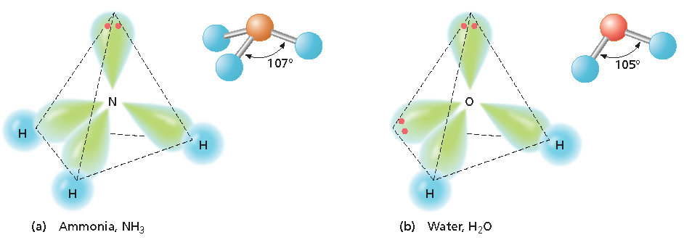

Slide 14
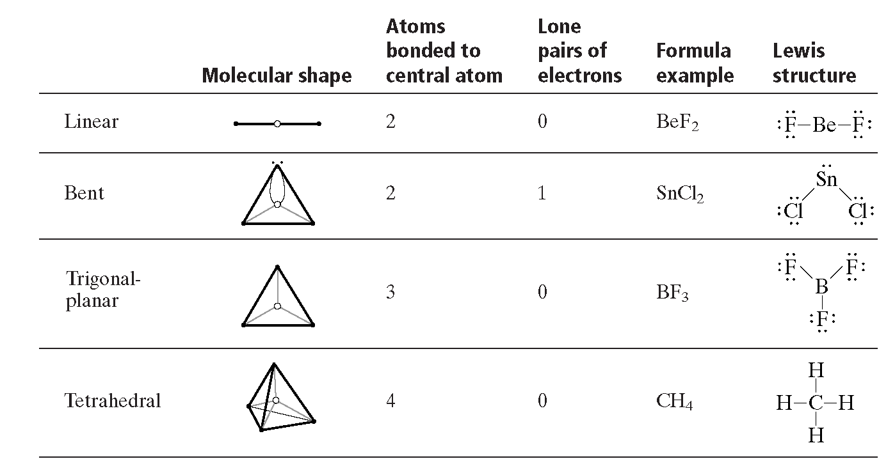

Slide 15
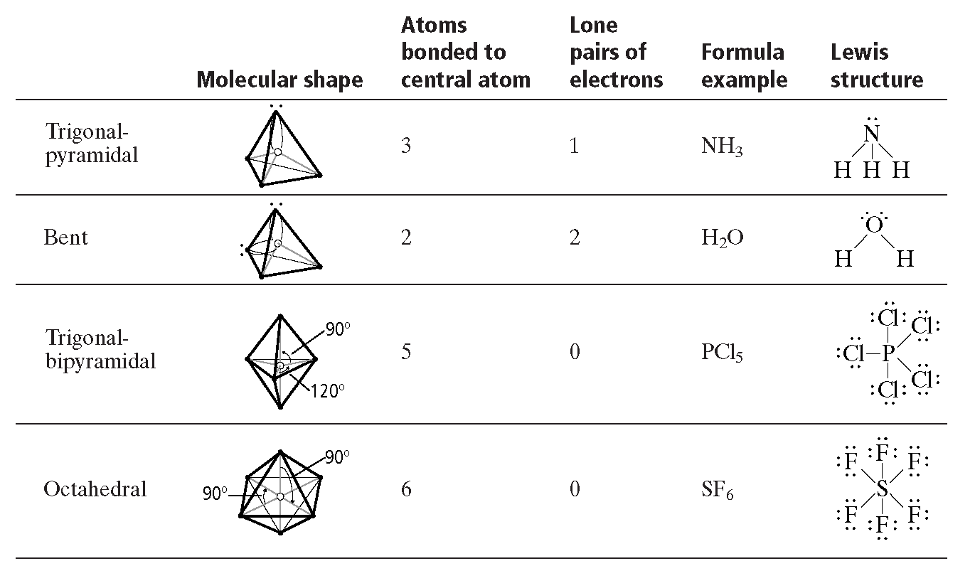

Slide 16
Chapter 6
Section 5 Molecular Geometry
VSEPR Theory, continued
Sample Problem F Solution
Draw the Lewis structure of carbon dioxide.
There are two carbon-oxygen double bonds and no unshared electron pairs on the carbon atom.
This is an AB₂ molecule, which is
linear.

Slide 17
IV. Hybridization
Explains how atoms rearrange when an atom forms covalent bonds.
Methane is a great example; CH₄
Hybridization-
  Mixing two or more atomic orbitals of similar energies on the same atom to produce new hybrid atomic orbitals of equal energies. It explains bonding and geometry of many molecules.

Slide 18
V. Intermolecular Forces
Forces of attraction between molecules.
The strongest exist between polar molecules. Because of their uneven charge distribution Dipoles are created by equal but opposite charges that are separated by a short distance.

Slide 19
London dispersion forces:
An intermolecular attraction resulting from the constant motion of electrons and the creation of instantaneous dipoles.

Slide 20
A temporary attractive force that results when the electrons in two adjacent atoms occupy positions that make the atoms form temporary dipoles. London forces are the attractive forces that cause nonpolar substances to condense to liquids and to freeze into solids when the temperature is lowered sufficiently.

Slide 21
Hydrogen Bonding
Dipole-dipole force
H bonding- Intermolecular force where H atom is bonded to a highly electronegative atom is attracted to an unshared pair of electrons of an electronegative atom in a nearby molecule
Because of the large electronegativity differences between H atoms and say F, O, or N the bonds connecting them are highly polar thus, makes their boiling points unusually high

