Slide 1
Ionic Bonding
Bonding part 3

Slide 2
Objectives:
Compare Chemical formulas and molecular compounds for Ionic compound
Arrange ions in crystals
Lattice energy
Ionic properties
Lewis structure for polyatomic ions

Slide 3
Outline:
I. Ionic compounds
II. Lattice Energy
III. Comparing Ionic and Molecular compounds
IV. Identifying Ionic Compounds
V. Polyatomic ions

Slide 4
I. Ionic compounds
Rocks and minerals of Earth consist of positive and negative ions held together by ionic bonds
Ionic compound- a positive and negative ion combined so the numbers of each charge equals
Most are crystalline solids

Slide 5
The crystal is a three-dimensional network of + & - ions mutually attracted to each other
Unlike molecular compounds, ionic neutral, independent units cannot be isolated

Slide 6
Chemical formulas for ionic compounds represents the simplest ratio of compound’s ions.
NOT the molecules!
Formula unit- simplest collection of atoms where an ionic compound's formula can be established.

Slide 7
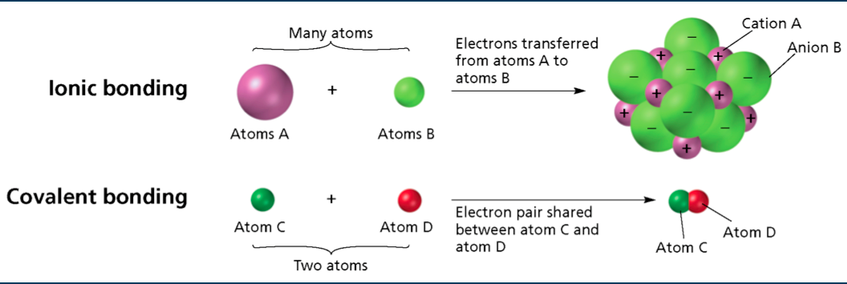
Ionic Vs. Covalent Bonding

Slide 8
The sodium atom has one valence electrons and the chlorine atom has seven valence electrons.
Atoms of sodium and other alkali metals easily lose one electron to form cations.
Atoms of chlorine and other halogens easily gain one electron to form anions.

Slide 9
II. Lattice Energy
Ions minimize their potential energy by arranging in a crystal lattice
    Attractive forces exists between opposite charged ions in the lattice.
    Repulsive forces exist between like-charged ions within the lattice

Slide 10
The combined attractive and repulsive forces in the crystal lattice determine:
    The distance between ions
    The pattern of ions’ arrangement in the crystal

Slide 11
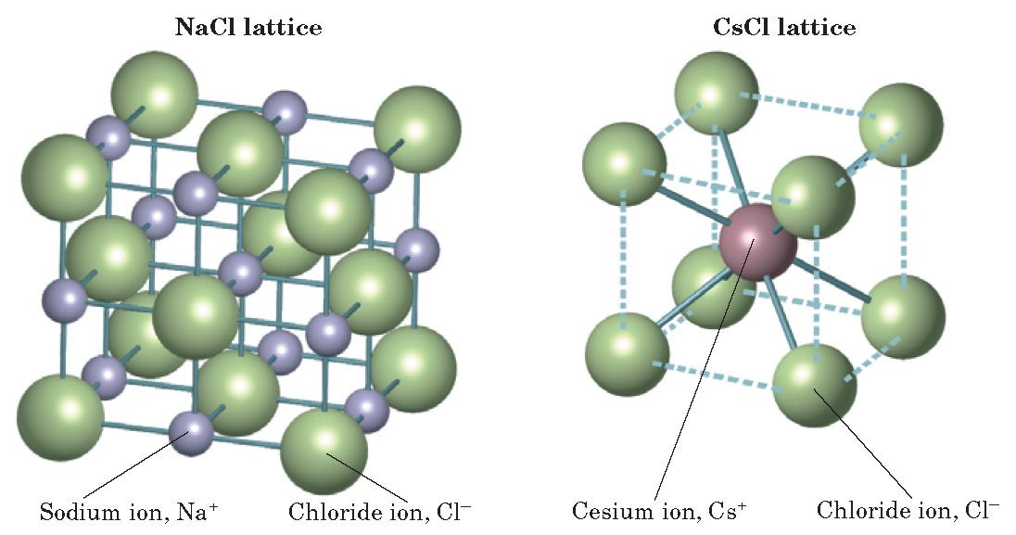
A Lattice:

Slide 12
III. Comparing Ionic & Molecular compounds
A very strong electrostatic attractive force holds ions together in an ionic compound.
Remember, forces between molecules or a covalent compound is MUCH weaker.
These differences in strengths give different properties between the types of compounds.

Slide 13
Comparison cont.
Covalent compounds:
  Low melting temperatures.
  Weak forces between individual molecules.
Ionic compounds:
  Strong attraction between ions .
  Very high melting points.
  Hard but brittle.
  NOT electrical conductors in solid BECAUSE the ions CANNOT move!

Slide 14
IV. Identifying Ionic Compounds
Examine sample:
    solid at room temperature (may or may not be ionic compound)
Tap sample gently:
    Hard and brittle, if ionic should not break apart easily.
Heat sample:
    Ionic compounds generally have high melting/boiling points.

Slide 15
OR YOU CAN:
Dissolve sample:
    Conductivity apparatus to see if it conducts electric current. Ionic compounds conduct electric currents when dissolved in water.

Slide 16
V. Polyatomic Ions
Polyatomic Ions- a charged group of covalently bonded atoms.
They have a charge that results from either a shortage or excess of electrons.
These are certain atoms that bond covalently with one another to form a group of atoms that have MOLECULAR AND IONIC characteristics.

Slide 17
Hey know anywhere you can see examples all hour long?

Slide 18
Determining the charge of a Polyatomic ion.
Example: NH₄⁺ (ammonium)
  The seven protons in the nitrogen atom plus the four protons in the four hydrogen atoms give the ammonium ion a total positive charge of 11+.
  When nitrogen and hydrogen atoms combine to form an ammonium ion, one of their electrons is lost, giving the polyatomic ion a total negative charge of 10–.
  The total charge is therefore: (11+)+(10-)=1+

Slide 19
Helpful Tip:
Covalent Bond:
  Nonmetal + Nonmetal
Ionic Bond:
  Nonmetal + Metal
Metallic Bond:
  Metal + Metal

