Slide 1
Gas Laws
Fisher

Slide 2
Pressure and force
Pressure (P)- the force per unit area on a surface
Gas pressure- caused by collisions of gas molecules with each other and/or with surfaces they contact
Pressure exerted by a gas depends on volume, temperature and number of molecules present
Higher pressures are a result of greater numbers of collisions of gas molecules.

Slide 3
Pressure and force
Unit for force is a Newton (N). Force will increase the speed of 1kg mass by 1 meter/sec.
Example: a person has a mass of 51 kg and Earth’s gravity has an acceleration of 9.8 m/s² .
So the force a person exerts on the ground is 51 kg X 9.8 m/s² so 500kg X m/s² = 500 N

Slide 4
Pressure and Force
Since pressure is force per unit area the pressure of the 500 N person on flooring that is 325 cm² is…
500 N / 325 cm² = 1.5 N/cm²
Greater force on an area then the greater the pressure.
Smaller area with a given force then the greater the pressure.
Couch example

Slide 5
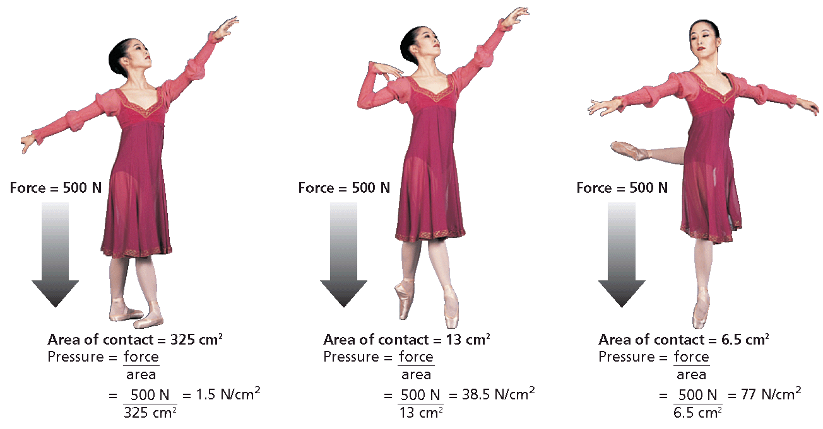

Slide 6
Pressure and force
Pressure is measured with a barometer (measures atmospheric pressure) Evangelista Torricelli 1600’s
1 torr = 760 mm based on his work with mercury, sealed glass tube then inverted the sealed tube (on one end) into a dish of mercury. The mercury rose about 30 in (760mm) about 1/14 of 34 feet.

Slide 7
Pressure and force
Common unit of pressure is mm Hg
1mm Hg is 1 torr.
Atmospheres also are used to measure pressures. Atmospheric pressure at sea level (0°C) is 760 mm Hg or 1 atmospheric pressure (atm)
So 1 torr = 760 mm Hg = 1 atm = 101.325 kPa

Slide 8
Pressure and Force
Pressure is expressed in pascals (Pa), pressure exerted by a force of 1 newton (1 N) on an area of 1 square meter.
Named for Blaise Pascal, French 17th century.
1 pascal is very small so it is expressed in kilopascals (kPa).

Slide 9
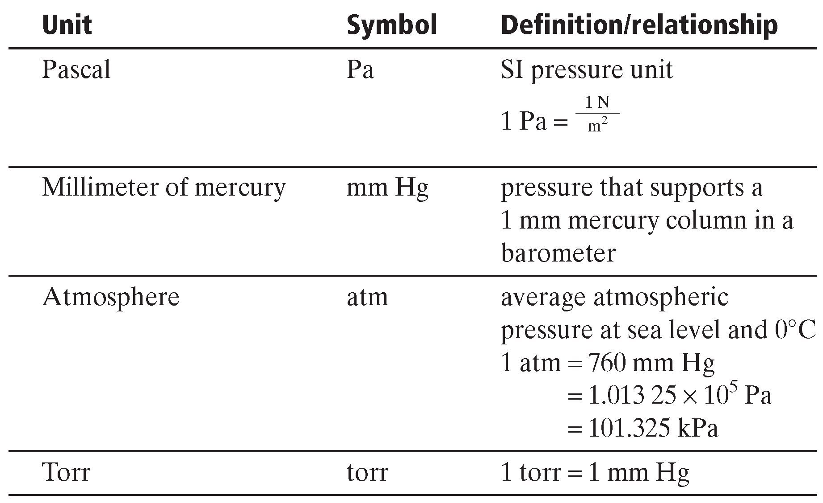

Slide 10
Pressure and Force Practice Problems
Denver, CO.
Average atm pressure is 0.830 atm.
Please state in mm Hg
Please state in kPa

Slide 11
Pressure and Force Practice problems
Given: atm pressure = 0.830 atm
Unknown: mm Hg

Slide 12
Pressure and Force Practice problems
Given: atm pressure = 0.830 atm
Unknown: kPa

Slide 13
Stop Here and Practice (end of day 1)

Slide 14
Dalton’s Law of Partial Pressures
Partial pressure – pressure of each gas in a mixture
John Dalton, proposed atomic theory, Each gas in a mixture is independent of pressure exerted by other gases present.

Slide 15
Dalton’s Law of Partial Pressures
Law of partial pressures – total pressure of a gas mixture is sum of partial pressures of the component gases.
Gases produced in a lab are referred to as; collected over water. Gas produced by rxn displaces water in the rxn bottle.
Vapor pressure- molecules at the liquid surface evaporate and mix with the gas molecules. Water molecules react this way and it is referred to as water vapor.

Slide 16
Dalton’s Law of Partial Pressures
Determine pressure of gas in a collection bottle is expressed with the equation;
P_{atm} = P_{gas} + P _{H2O}
Raising a bottle until water levels are the same inside and out results in pressures being equal inside and outside the bottle.

Slide 17
Dalton’s Law of Partial Pressures Practice problem
Oxygen gas from the decomposition of potassium chlorate, KClO₃, was collected by water displacement. The barometric pressure and the temperature during the experiment were 731.0 torr and 20.0°C. respectively. What was the partial pressure of the oxygen collected?

Slide 18
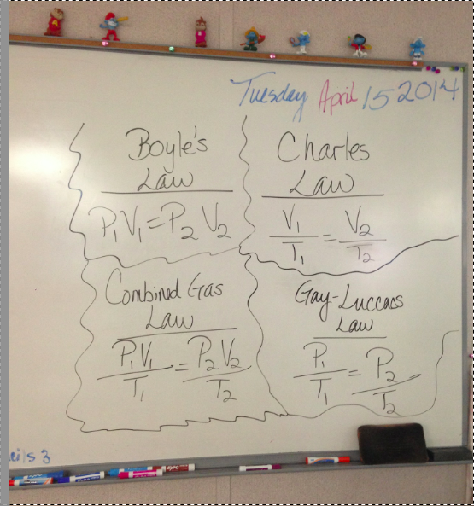
Gas Laws

Slide 19
Avogadro’s Law
Avogadro’s Law – equal volumes of gases at same temperature and pressure contain equal number of molecules
Additionally, gas volume is directly proportional to amount of gas at given pressure and temperature.

Slide 20
Avogadro’s Law
Applies to combining volumes in gas rxns
Standard molar volume of a gas – volume occupied by one mole of gas at STP is 24.41410 L (22.4 L)
One mole of any gas will occupy the same volume as one mole of any other gas at same conditions, even with differences in mass

Slide 21
Avogadro’s Law
This is cool because you can use the molar volume of a gas to find the volume, at STP, of a known number of moles or known mass of gas.
It is all about converting to the unit you need.

Slide 22
Avogadro’s Law
Example:
You can also use the molar volume of a gas to find the volume, at STP, of a known number of moles or a known mass of gas.
example: at STP, 0.768 mol of gas x (22.4 L / 1 mol) = 17.2 L of gas

Slide 23
Avogadro’s Law Practice problems
What volume does 0.0685 mol of gas occupy at STP?
What quantity of gas, in moles, is contained in 2.21 L at STP?

Slide 24
Gas SToichiometry
Coefficients in chemical equations of gas rxns reflect molar ratios AND volume ratios (conditions must remain the same for this to be true)

Slide 25
Gas stoichiometry
example—reaction of carbon dioxide formation:
2CO(g) + O₂(g) → 2CO₂(g)
2 molecules 1 molecule 2 molecules
2 mole 1 mole 2 mol
2 volumes 1 volume 2 volumes

Slide 26
Gas stoichiometry
2CO(g) + O₂(g) → 2CO₂(g)
2 molecules 1 molecule 2 molecules
2 mole 1 mole 2 mol
2 volumes 1 volume 2 volumes
You can use the volume ratios as conversion factors in gas stoichiometry problems as you would mole ratios:

Slide 27
Gas stoichiometry
Propane, C₃H₈, is a gas that is sometimes used as a fuel for cooking and heating. The complete combustion of propane occurs according to the following balanced equation.
C₃H₈(g) + 5O₂(g) → 3CO₂(g) + 4H₂O(g)
(a) What will be the volume, in liters, of oxygen required for the complete combustion of 0.350 L of propane?
(b) What will be the volume of carbon dioxide produced in the reaction? Assume that all volume measurements are made at the same temperature and pressure.

Slide 28
Gas stoichiometry
A. Because all volumes are to be compared at the same conditions, volume ratios can be used like mole ratios.

Slide 29
Gas stoichiometry
B. Because all volumes are to be compared at the same conditions, volume ratios can be used like mole ratios.

Slide 30
Ideal Gas Law!!
This is a combination of all the gas laws we have learned about. Yes!
This is a mathematical relationship among P, V, T and number of moles (n) of a gas.
R is a constant
PV = nRT

Slide 31
Gas stoichiometry
Calculated value of R is rounded to 0.0821 (L•atm)/(mol•k)
Used when V in L, P in atm, T in kelvins
Applied in determining existing conditions of a gas sample when P,V,T and n are known.

Slide 32
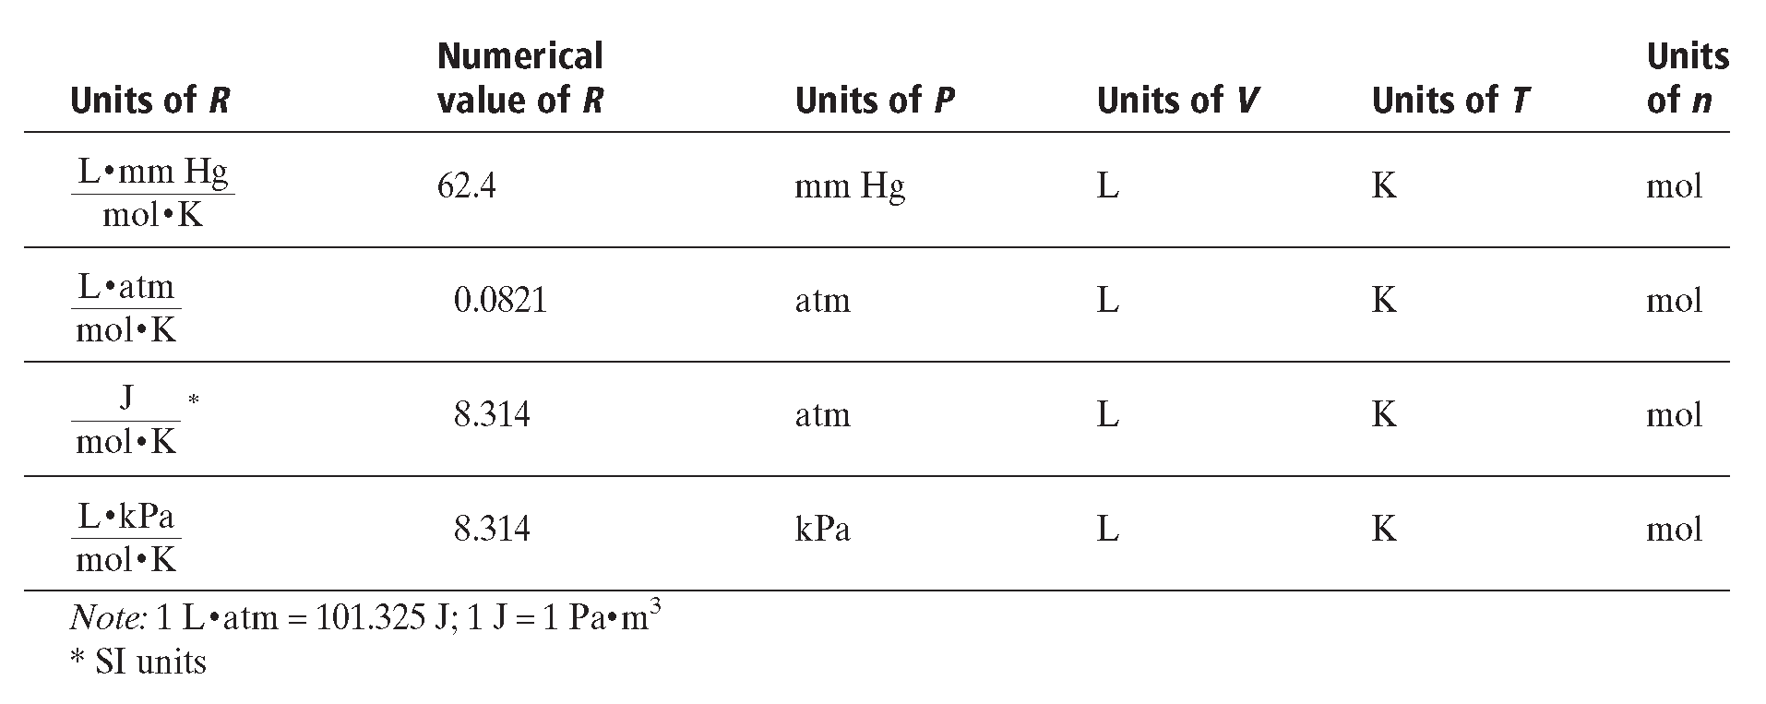
Gas stoichiometry Values of a Gas Constant

Slide 33
Gas stoichiometry Practice Problem
What is the pressure (atm) exerted by a 0.500 mol sample of N gas in a 10.0L container at 25°C?
PV = nRT
P = nRT/V

Slide 34
The pressure of Nitrogen gas is 1.22 atm.

Slide 35
Diffusion and Effusion
Diffusion and Effusion depend on relative velocities of gas molecules. Gas varies inversely with the square root of its molar mass.
Average kinetic energy of molecules in any gas depends on the temperature and equals 1/2mv²

Slide 36
Diffusion and Effusion
Graham’s law of effusion – rates of effusion of gases at the same temperature and pressure are inversely proportional to the square roots of their molar masses.

Slide 37
Diffusion and Effusion Practice Problem!
Compare rates of effusion of H and O at same temperature and pressure.

Slide 38
Diffusion and Effusion
Hydrogen effuses 3.98 times faster than oxygen.

Slide 39
Diffusion and Effusion

Slide 40
Diffusion and Effusion

