Slide 1
Acids and Bases
Chapter 14 Modern Chemistry Book

Slide 2
Acids
Have a sour taste (aq solutions).
Change color of acid-base indicators.
Some acids react with active metals and release hydrogen gas, H_{2.}
React with bases to produce salts and water.
Conduct electric current.
Ba(s) + H₂SO₄(aq) BaSO₄(s) + H₂(g)

Slide 3
Acids
Binary acid (has two different elements), H⁺ and one of the more electronegative.
HF, HCl, HBr and HI
Nomenclature:
Name of binary acid begins with the prefix hydro-.
Root of name of the second element follows prefix hydro.
Name ends with the suffix –ic.

Slide 4
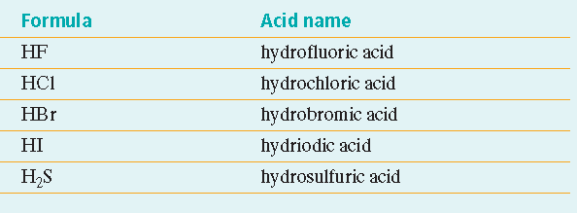
Acids

Slide 5
Acids
Oxyacid- acid is compound of H⁺, O⁻ and 3rd element usually a nonmetal:
HNO₃ or H₂SO₄
Nomenclature:
Names of their anions are based on the names of the acids.

Slide 6
Acids
Common Industrial Acids:
Sulfuric Acid
Nitric Acid
Phosphoric Acid
Hydrochloric Acid (concentrated solutions are referred to as muriatic acid).
Acetic Acid

Slide 7
Bases
Bases taste bitter (aqueous solutions).
Change the color of acid-base indicators.
Dilute aq solutions of bases feel slippery.
React with acids to produce salts and water.
Bases conduct electric current.

Slide 8
Arrhenius Acids and Bases
Arrhenius Acid- chemical compound that increases the [H⁺] (concentration of hydrogen ions) in aq solutions.
Arrhenius Base- substance increases the [OH⁻] (concentration of hydroxide ions) in aq solutions.

Slide 9
Aqueous acids are electrolytes. These are molecular compounds with ionizable hydrogen atoms.

Slide 10
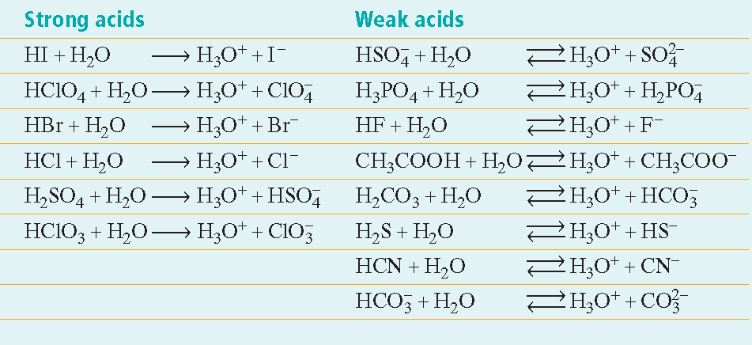
Strong/Weak acids

Slide 11
Strong & Weak Acids
Strong acid- ionizes completely in aq solution.
Strong acid is a strong electrolyte
HClO₄, HCl and HNO₃
Weak acid- releases few H ions in aq solution.
Hydronium ions, anions and dissolved acid molecules in aq solutions
HCN
Organic acids (-COOH) like acetic acid

Slide 12
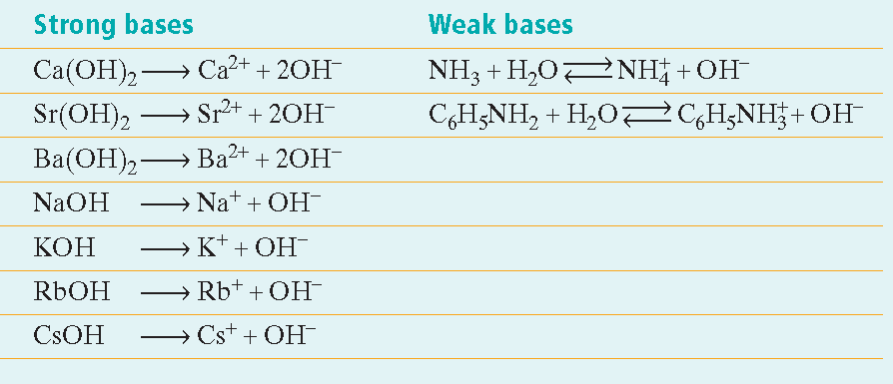
Most bases are ionic compounds containing metal cations and the hydroxide anion, OH⁻.
Strength of a base depends on the extent of the base dissociating.
Strong bases are strong electrolytes.

Slide 14
An Acid [H₃O⁺]
Proton acceptor or donator?
A Base [OH⁻]
Proton acceptor or donator?

Slide 15
Part 2
Bronsted-Lowry Acid; proton donor
Bronsted-Lowry Base; proton acceptor
In a Bronsted-Lowry acid-base reaction protons are transferred from one reactant (the acid) to another (the base).
HCl + NH₃ NH₄+ + Cl⁻
^{(acid) (base)}

Slide 16
Monoprotic acid- acid that can only donate one proton H per molecule. HClO₄
Diprotic acid- acid can donate two protons per molecule.
Triprotic acid- acid can donate three protons per molecule. H₃PO₄
Polyprotic acid- acid that can donate more than one proton per molecule. H2

Slide 17
Brønsted-Lowry Acids and Bases, continued
In a Brønsted-Lowry acid-base reaction, protons are transferred from one reactant (the acid) to another (the base).
acid base

